Slide 1
Google Authenticator -LIBPAM
122294 Seung-Jae Park
16011132 Hyun-Min Ko

Slide 2
Introduction
Google Authenticator Libpam is a software token that implements two-step verification services using the TOTP and HOTP, for authenticating users of applications by Google. This is a pluggable authentication module program which provides a six-digit one-time password which users must provide in addition to their username and password to log into Google services or other sites.
Linux Pluggable Authentication Modules (PAM) provide dynamic authentication support for applications and services in a Linux or GNU system.
->We are going to modify an open-source
: Google Authenticator-Libpam
Time-based One-time Password Algorithm (TOTP) is…

Slide 3
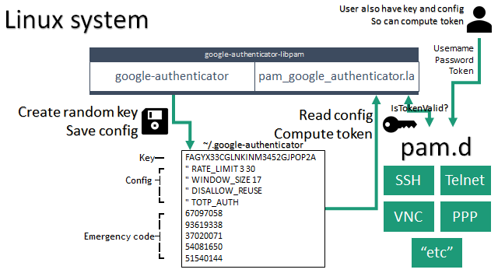
Introduction

Slide 4
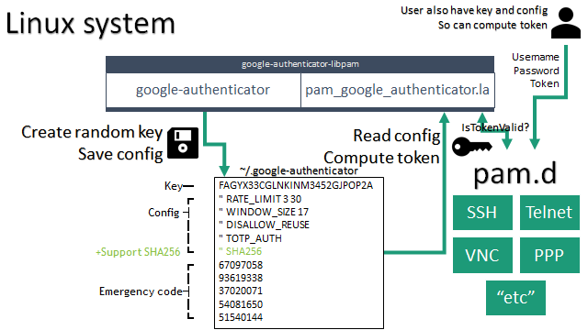
Introduction

Slide 5
Purpose-Work
Why SHA-1 isn’t safe?
SHA-1 is no longer considered secure against well-funded opponents. In 2005, cryptanalysts found attacks on SHA-1 suggesting that the algorithm might not be secure enough for ongoing use, and since 2010 many organizations have recommended its replacement by SHA-2 or SHA-3. Microsoft, Google, Apple and Mozilla have all announced that their respective browsers will stop accepting SHA-1 SSL certificates by 2017.

Slide 6
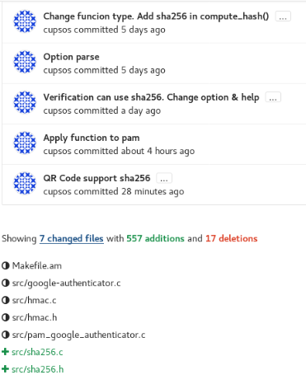
Modifying Code

Slide 7
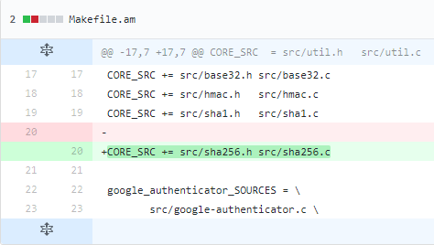
Modifying Code
Notification
Red parts->Deleted parts
Green parts-> Added parts
Makefile.am
20th
: Making new file to make a “make” file.

Slide 8
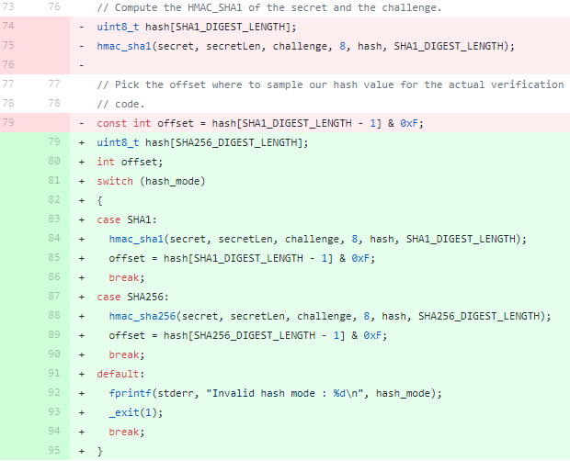
Modifying Code
Continues on src/google-authenticator.c
This app has a encryption based on SHA-1, which is weak.
76~95th:
Modifying encryption system
(While the original has only SHA-1 encryption, this codes enables SHA-1 and SHA-2)

Slide 9
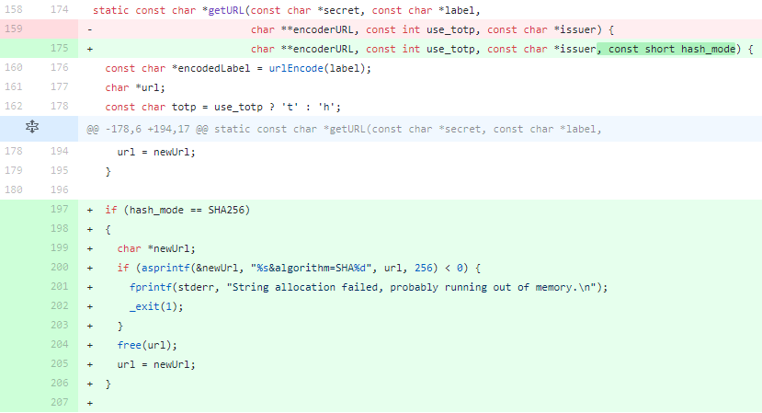
Modifying Code
Continues on src/google-authenticator.c
175~207^{th:} The user can see an QR code URL for login for “Google Chart Option”.

Slide 10
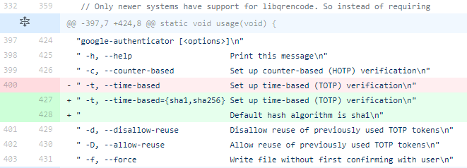
Modifying Code
Continues on src/google-authenticator.c
427~428th: Varied configuration

Slide 11
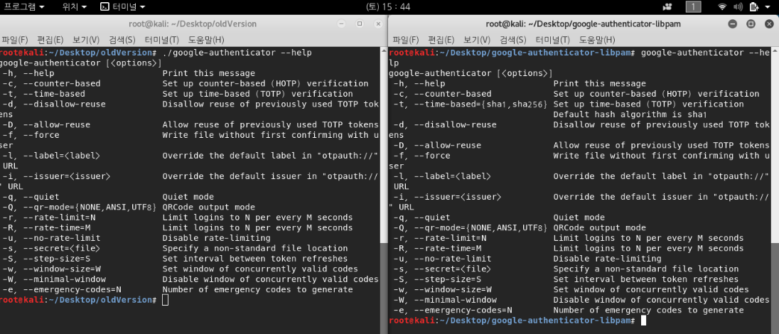
Modifying Code
Continues on src/google-authenticator.c
427~428th: Varied configuration
Left: The original open-source Right: New

Slide 12
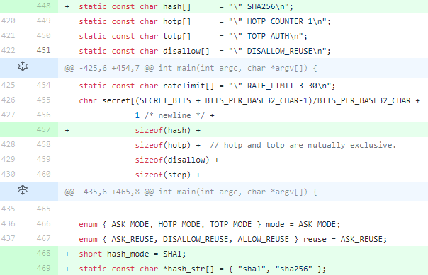
Modifying Code
Continues on src/google-authenticator.c
448, 457th : Make a file of configuration about OTP at file memory for a sake of cancelling the procedure.
468~468th: Hashing function

Slide 13
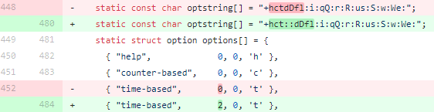
Modifying Code
Continues on src/google-authenticator.c
480 and 484th:
Showing “Reading option”

Slide 14
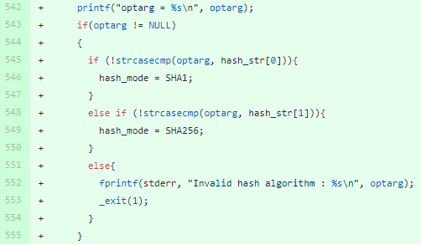
Modifying Code
Continues on src/google-authenticator.c
542~555th: Validity checking. If any errors occur, send a repudiation message.

Slide 15
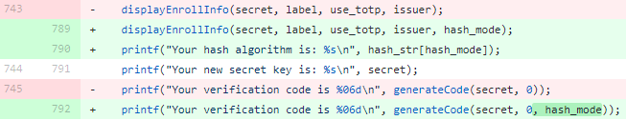
Modifying Code
Continues on src/google-authenticator.c
789~792th: Print out successful hash algorithm functioning.

Slide 16
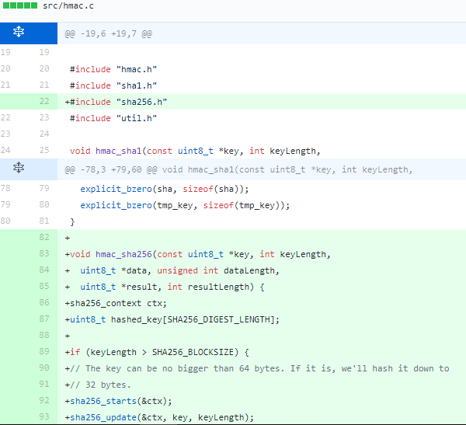
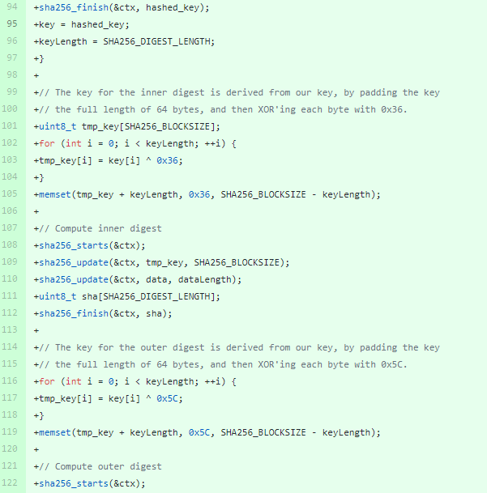
Modifying Code
src/hmac.c
Hash function header and algorithm.

Slide 17
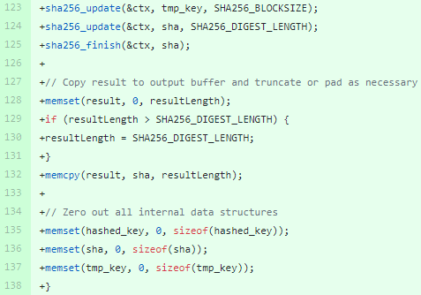
Modifying Code
src/hmac.c
Hash function header and algorithm.

Slide 18
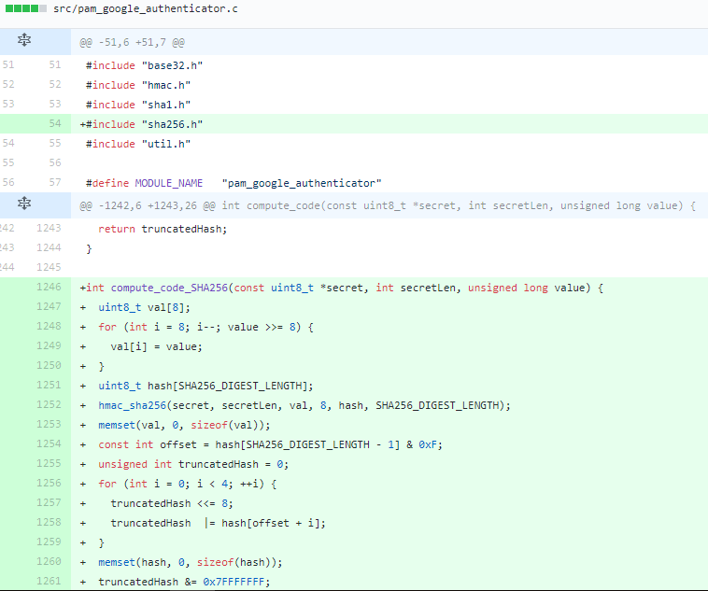
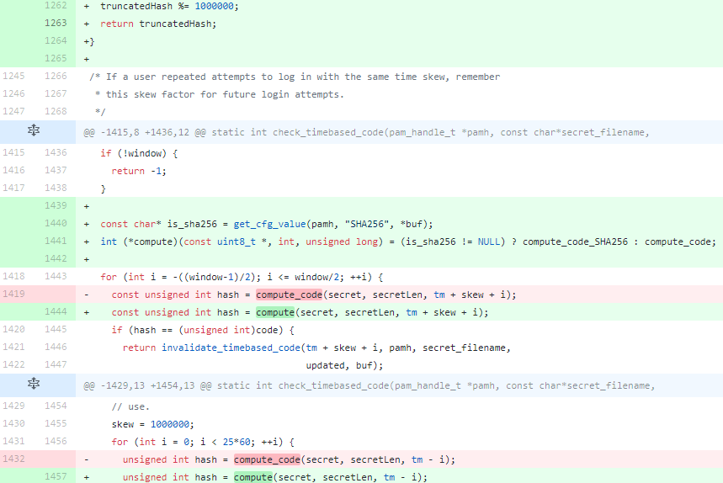
Modifying Code
src/pam_google_authenticator.c
Codes what are really executed while login process.

Slide 19
Results
Please have a look at this video

Slide 20
Verification
Create random key
Save at config.

Slide 21
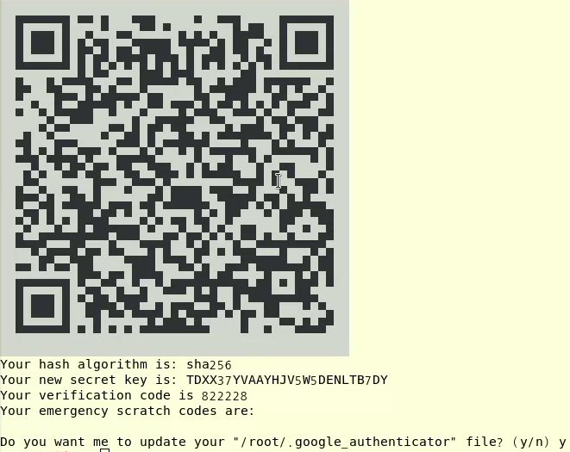
Verification
Generated verification code must be typed at the app for identification.

Slide 22

Verification
If the password isn’t correct, the app requires valid password, again.
Otherwise, progress next.

Slide 23
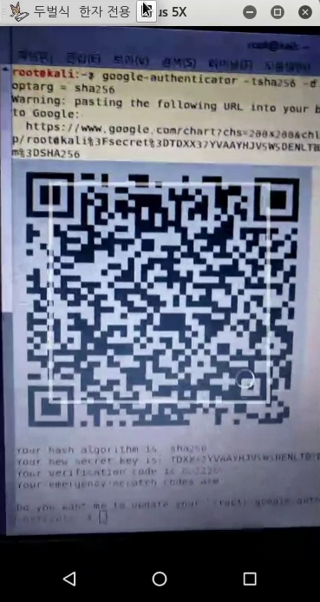
Verification
QR code is recognized it with smart-phone.

Slide 24
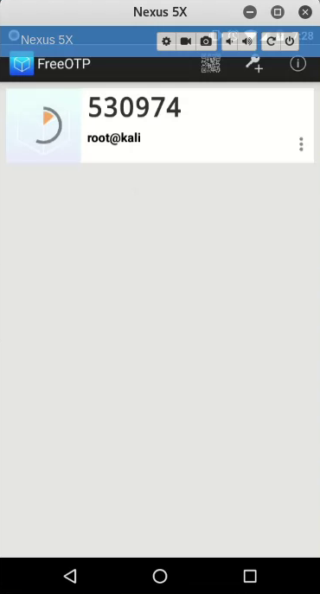
Verification
“530974” is another token.

Slide 25
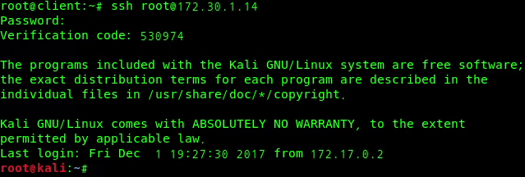
Verification
The user get an admission.
Successfully working.

Slide 26
Conclusion
Still some security standards applied on apps are not the latest.
Not only for this Google Authenticator, many apps should alter their secure measures latest.
C(Confidentiality): Security level gets higher than the original.
I(Integrity): The original version guarantees.
A(Availability and authentication): Safer authentication app

